Slide 1
How Computer Networks Work
Introduction

Slide 2
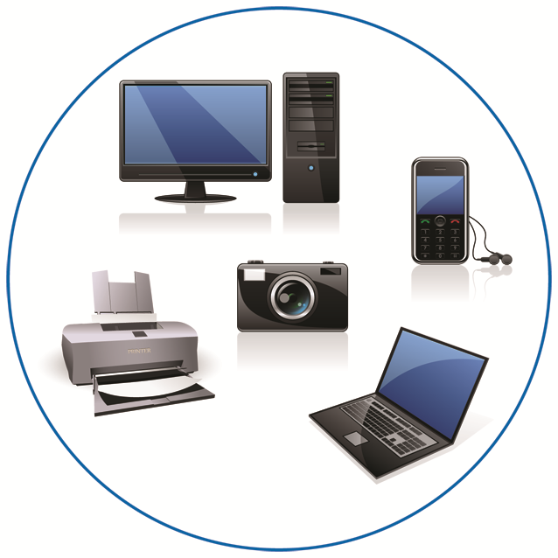
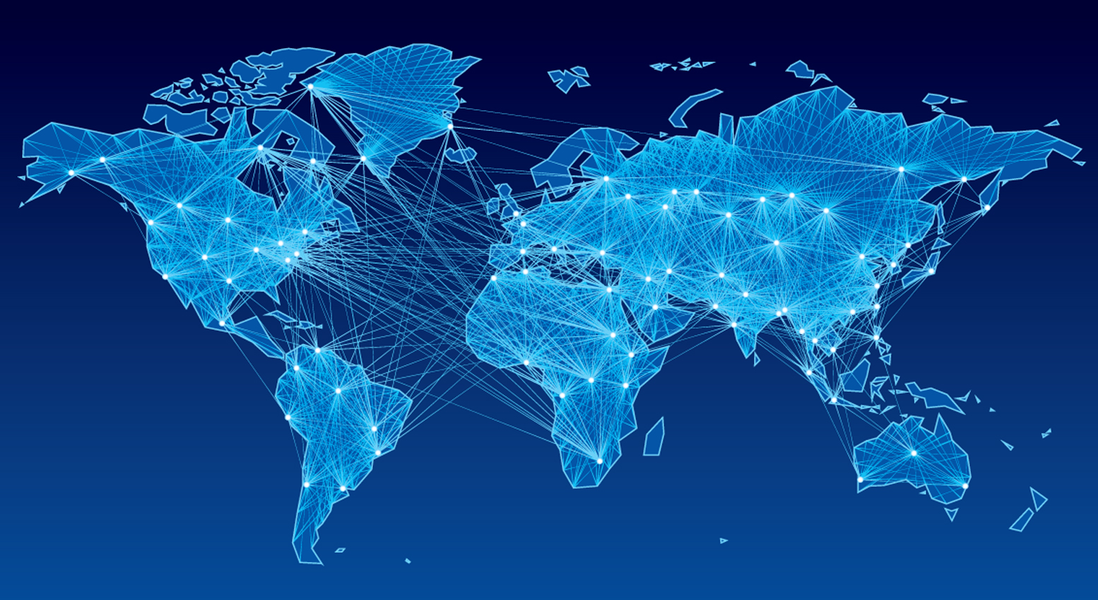
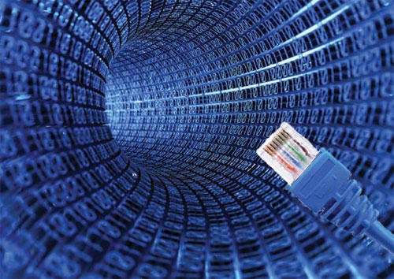
Networks
Dictionary: Network (n) - a system of interconnected computer systems, terminals, and other equipment allowing information to be exchanged
Can be as simple as two computers in one room or as large as thousands of computers all over the world

Slide 3
Network Classifications
Local area network (LAN)—Example: Computers in an office
Metropolitan area network (MAN)—Example: University or city
Wide area network (WAN)—Example: Company with offices around the world

Slide 4
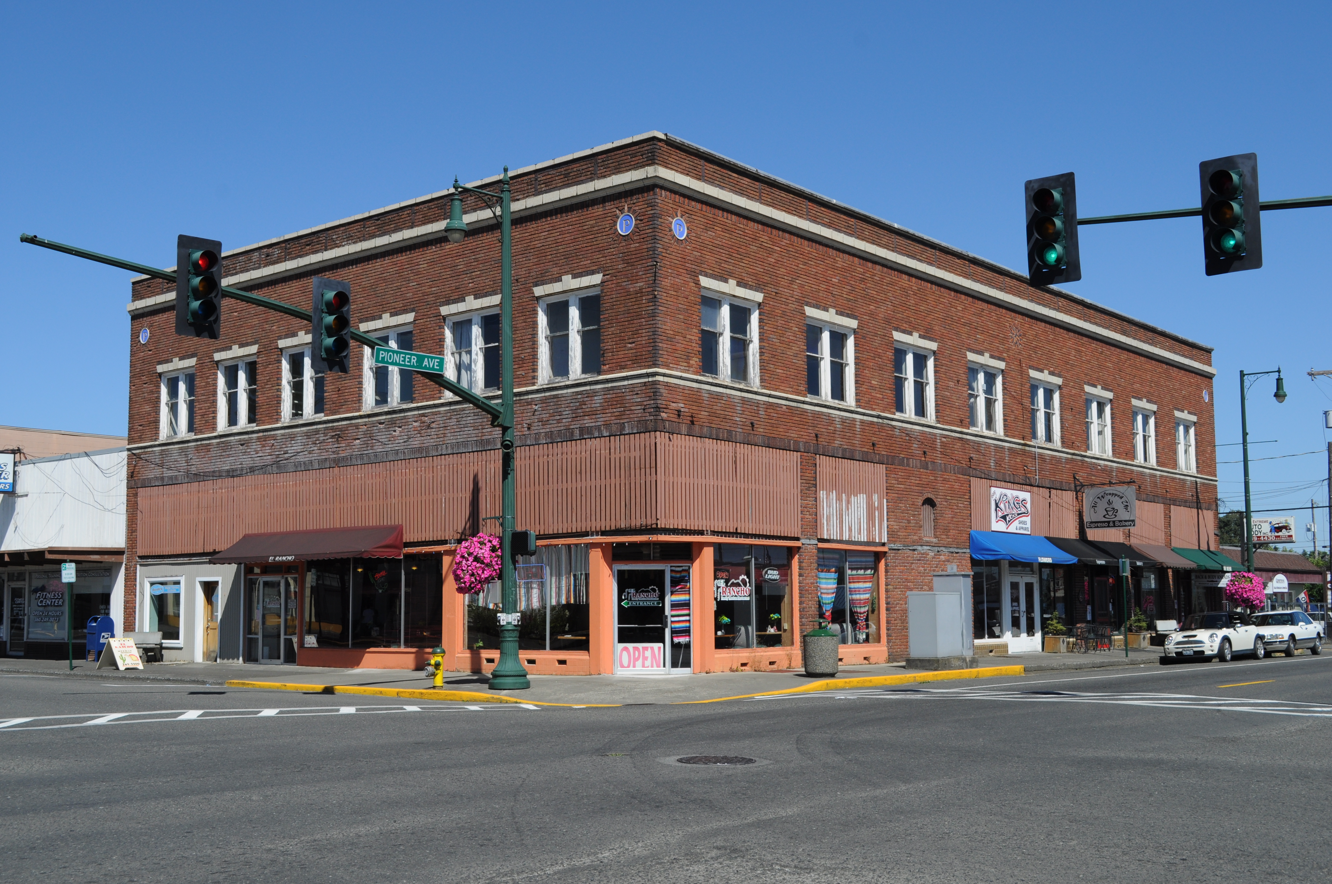
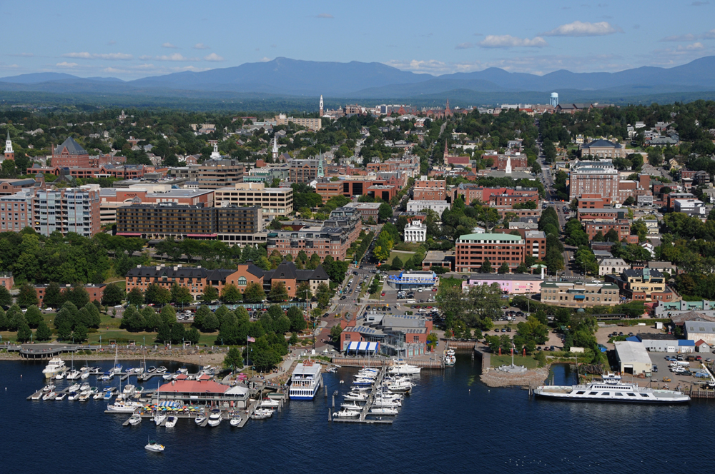
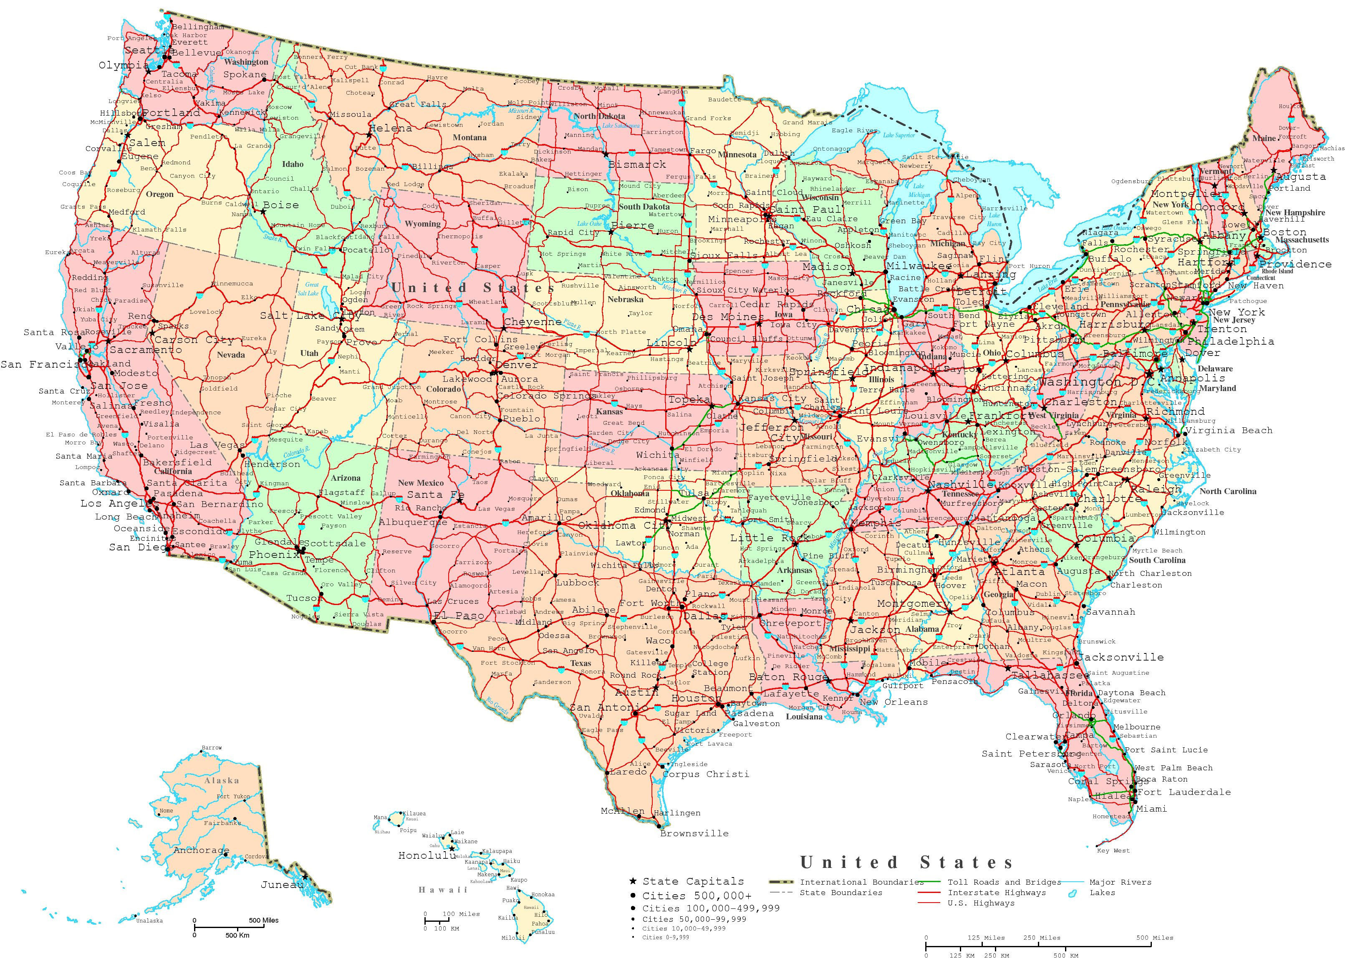
Network Classification
LAN
MAN
WAN

Slide 5
How Networks Work
How Routers and Switches Work

Slide 6
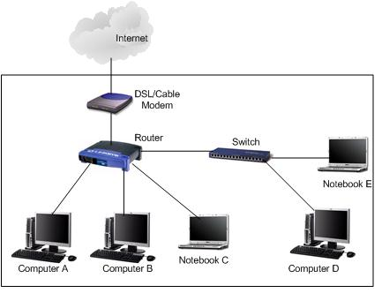
Basic Network Setup

Slide 7
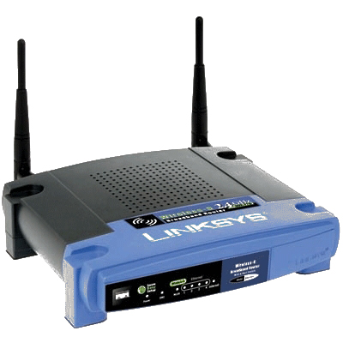
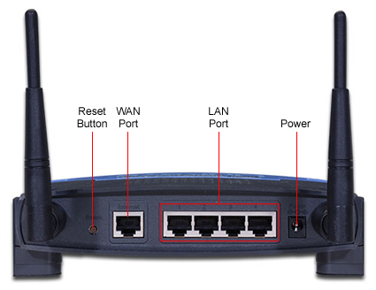
Wireless Router
Linksys WRT54GL Wireless Broadband Router

Slide 8
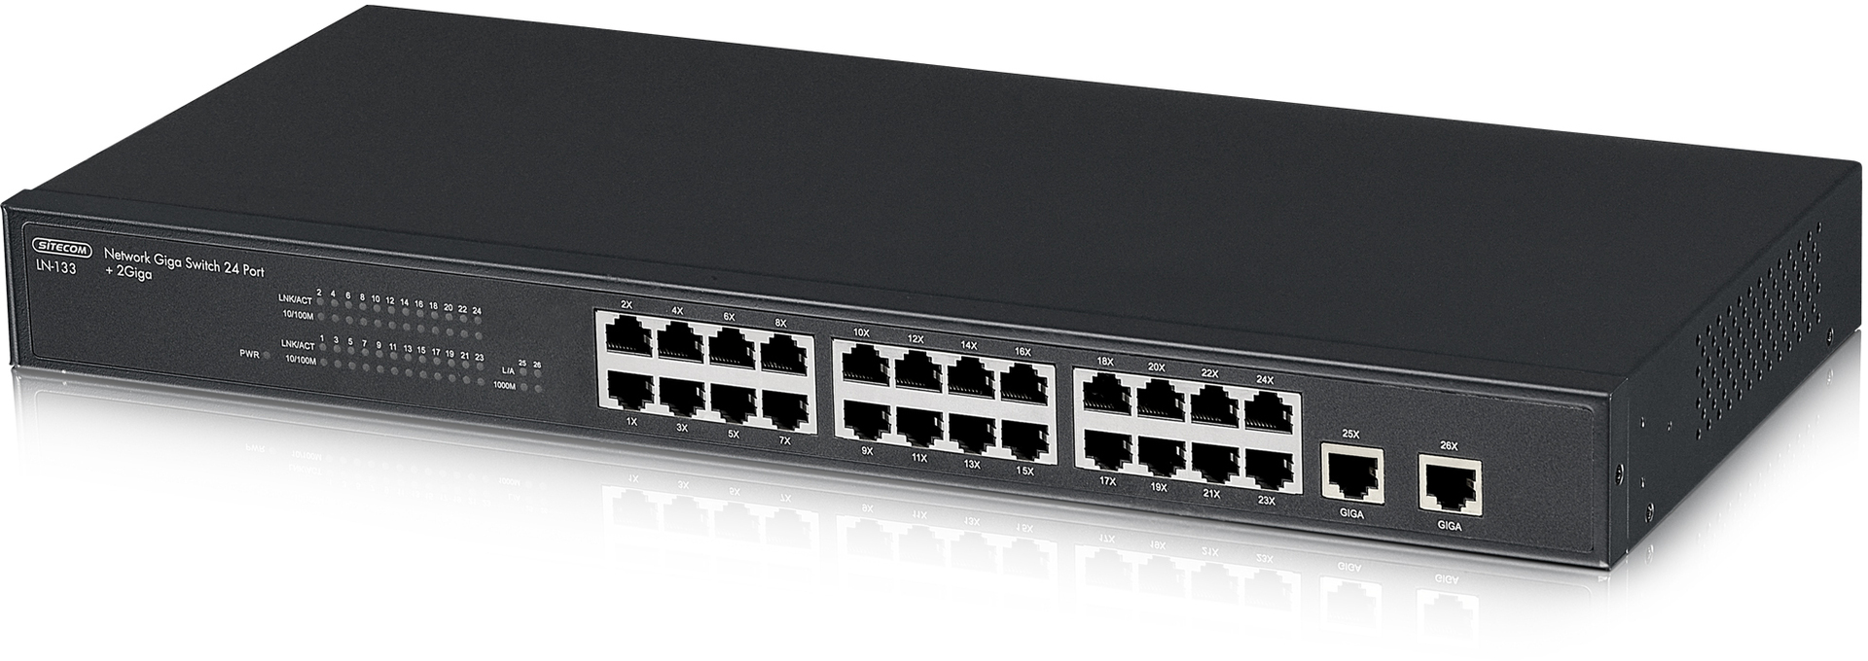
Switch
Multiple ports
Switch makes decision in hardware (internal main processer)
Designed to connect additional wired devices over Ethernet

Slide 9
Switch
A switch is used in a wired network to connect Ethernet cables from a number of devices together. The switch allows each device to talk to the others. Switches aren't used in networks with only wireless connections, since network devices such as routers and adapters communicate directly with one another, with nothing in between.
Although you can use the ports on the back of a router or modem to connect a few Ethernet devices together, depending on the model, switches have a number of advantages:
Switches allow dozens of devices to connect.
Switches keep traffic between two devices from getting in the way of your other devices using the same network.
Switches allow control of who has access to various parts of the network.
Switches allow you to monitor usage.
Switches allow communication (within your network) that's even faster than the Internet.
High-end switches have pluggable modules to tailor them to network needs.

Slide 10
Network Segmenting Devices
Physical devices can also be used to segment a network
Bridge and switch segment a network at the data link layer
A router segments the network at the network layer

Slide 11
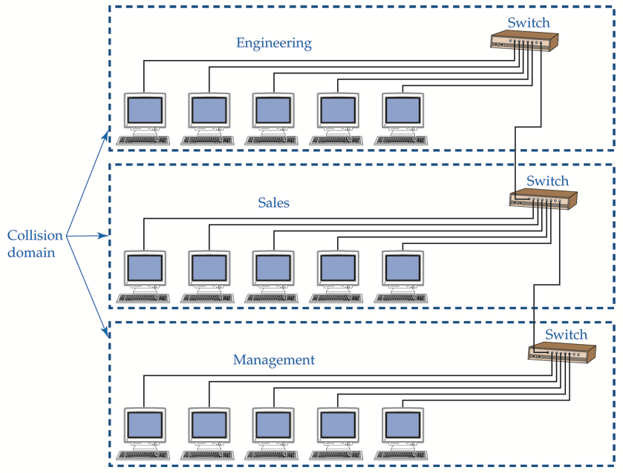
Segmenting with Switches or Routers

Slide 12
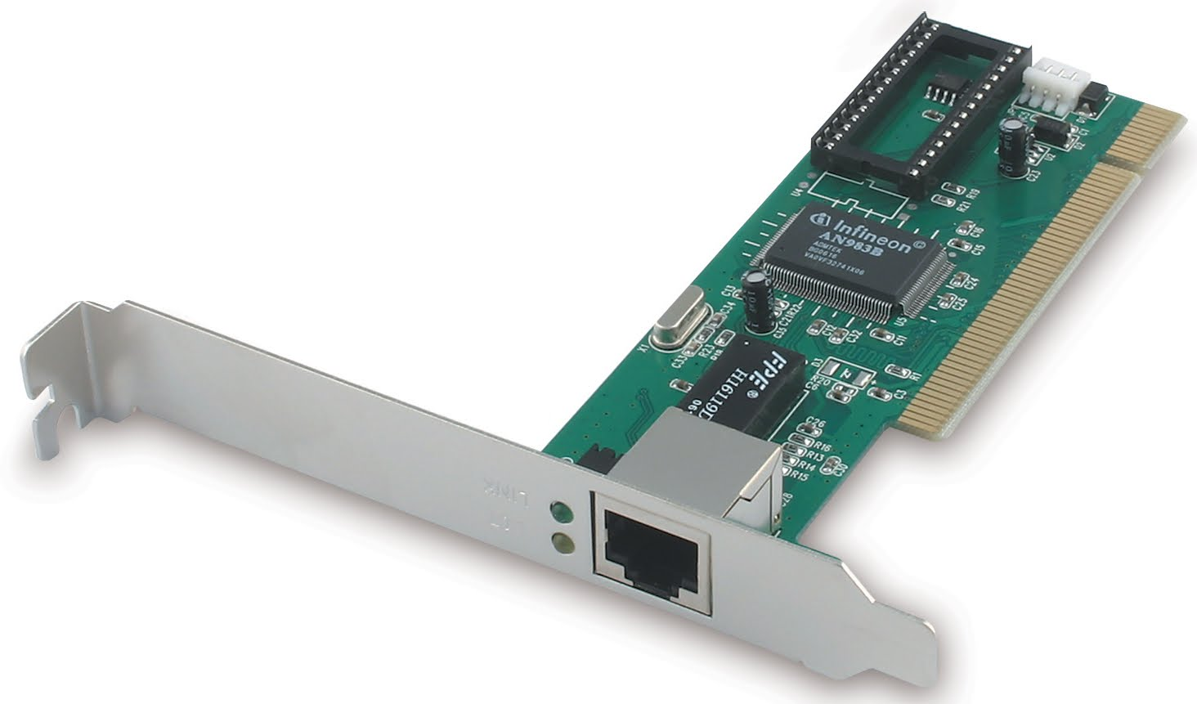
Network Interface Card (NIC)

Slide 13
Network Interface Card (NIC)
Must match physical communication requirements of the network
Requires driver to communicate with other computer hardware
Contains unique identifiers:
Physical: MAC (media access control) address
Logical identification: Computer name

Slide 14
Media Types
Copper core cable—Most common media; plastic or synthetic insulation
Network Cables—Cat5/5e, Cat6 Twisted pair
Fiber-optic cable—Has glass or plastic core
Radio waves—Carries signals in wireless networks
Infrared light—Beam used to transport digital signal

Slide 15
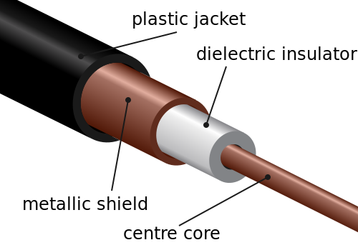
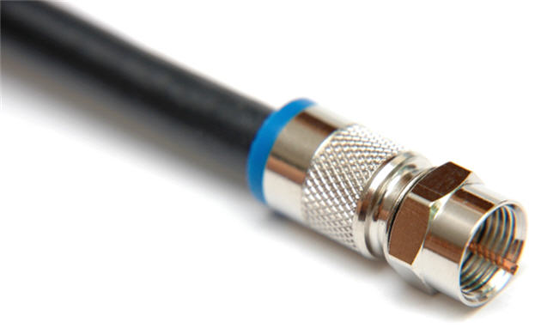
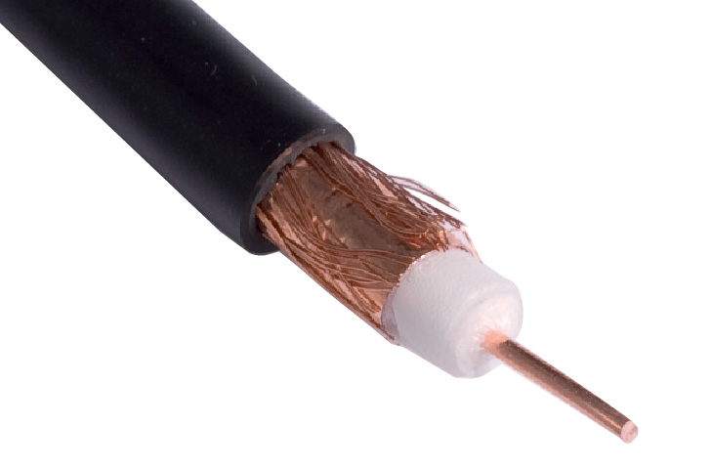
Coaxial Cable
Common Types: RG – 59, RG – 6
Number of Shields can be Single, Double, etc.

Slide 16
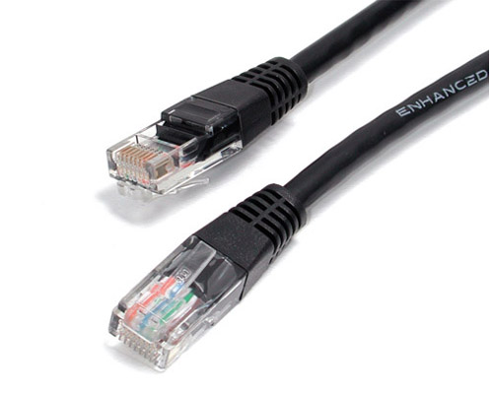
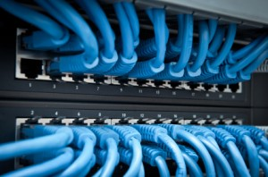
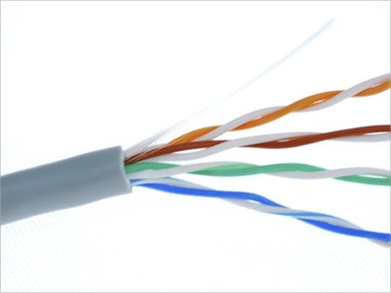
Network Cable
Category 5e (Cat 5e) standardized
cable for Ethernet

Slide 17
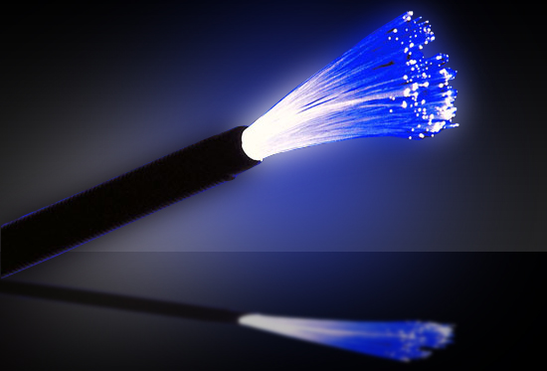
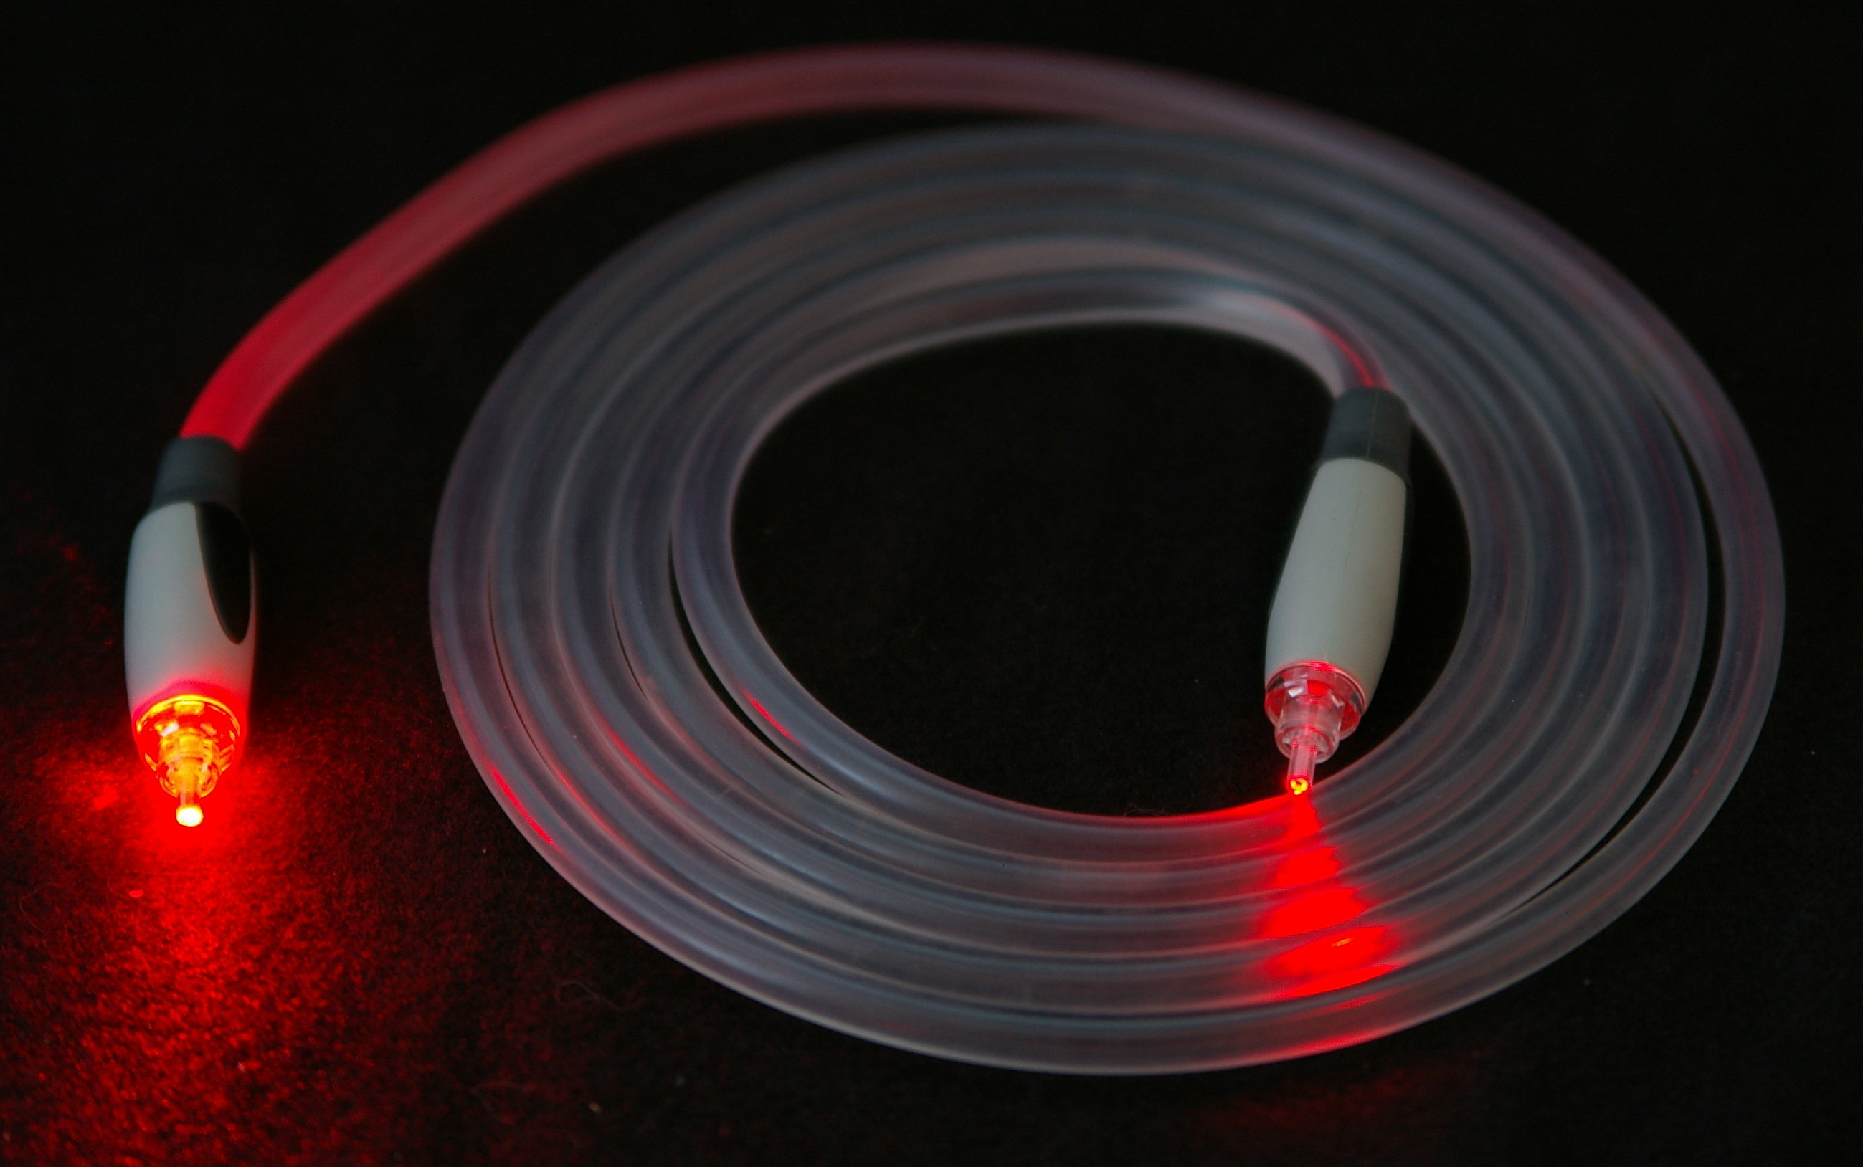
Fiber Optic

Slide 18
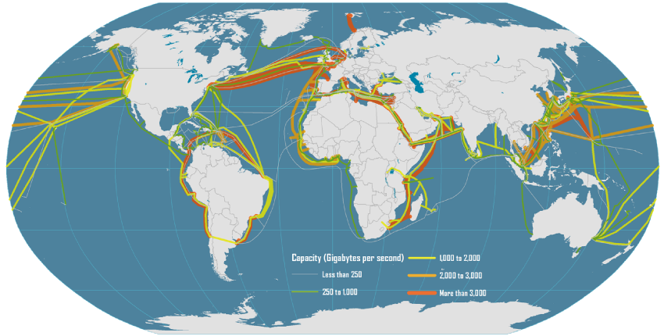
Transcontinental “Submarine” Network Cables

Slide 19
How Networks Work
How Wireless Networks Work

Slide 20
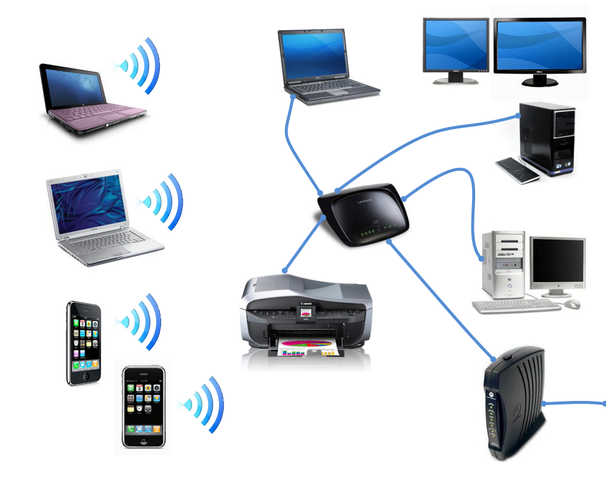
Typical Home Network

Slide 21
Service Set Identifier (SSID)
Identifies wireless network
Similar to workgroup name
All wireless network devices are configured with a default SSID (i.e., Linksys)
To secure the wireless network, the default SSID should be changed

Slide 22
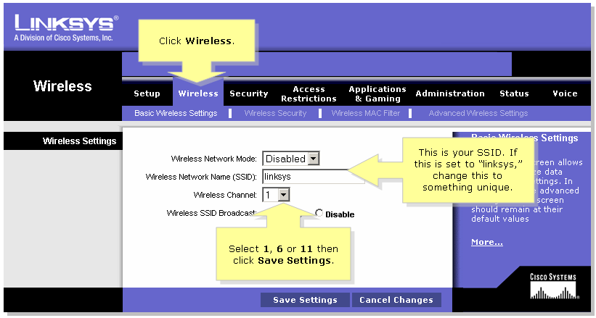
SSID

Slide 23
How Networks Work
How TCP/IP Works

Slide 24
Protocol
Set of rules governing communication between devices on a network
Determines:
How devices identify each other
Method of data exchange
Size of each packet
Timing for packet transmission
Signal to be used to end a session

Slide 25


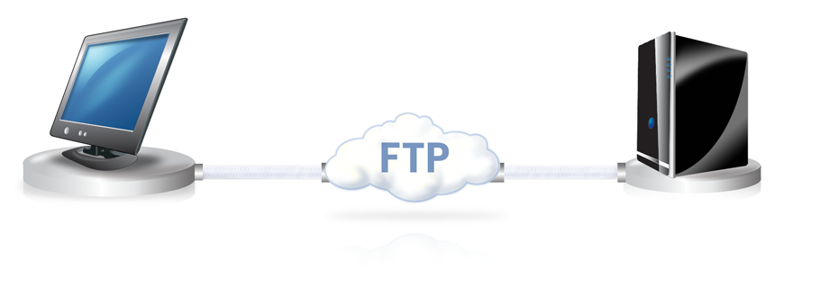
Protocols
TCP/IP (Transmission Control Protocol/Internet Protocol)—Provides Internet communication
HTTP (Hypertext Transfer Protocol)
FTP (File Transfer Protocol)—Used to transfer files from one host to another

Slide 26
TCP/IP
Suite of protocols that supports communication between network devices on a LAN and the Internet
All major operating systems
Use the TCP/IP protocol suite and IPv4 and IPv6 format
Each OS uses its own proprietary protocols to maintain backward compatibility with legacy OSs, and for file sharing and printer access

Slide 27
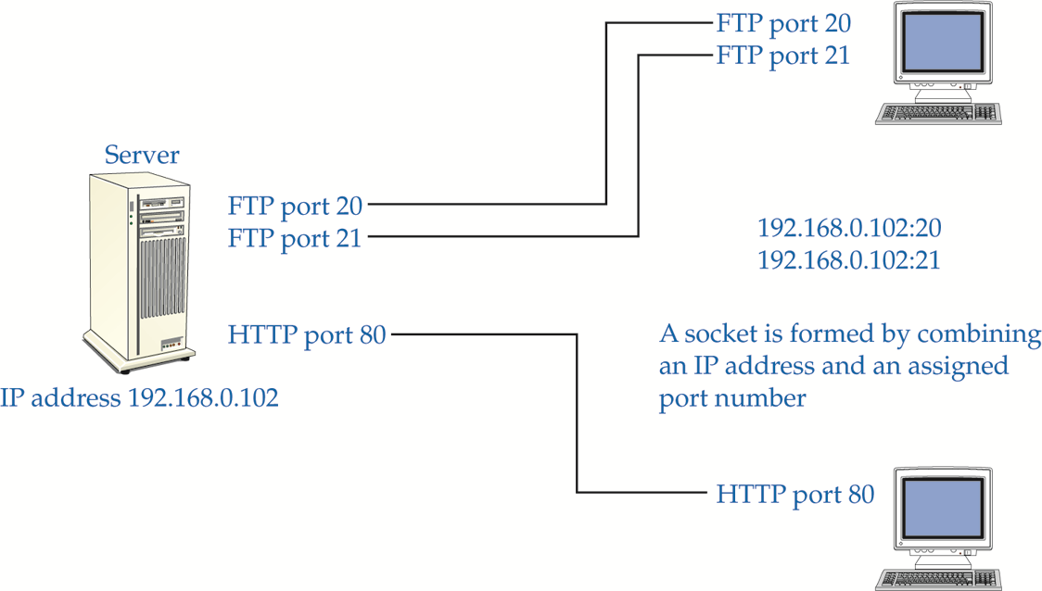
TCP/IP Ports and Socket
A port number combined with an IP address (socket) is used to create a virtual connection

Slide 28
Common Port Numbers
Service or Protocol | Port Number
FTP | 20, 21
SSH | 22
Telnet | 23
SMTP | 25
DNS | 53
TFTP | 69
HTTP | 80
POP3 | 110
NNTP | 119
NTP | 123
IMAP4 | 143
HTTPS | 443

Slide 29
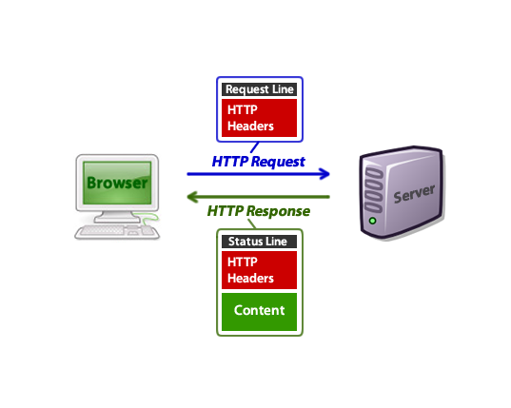
Hypertext Transfer Protocol (HTTP)

Slide 30
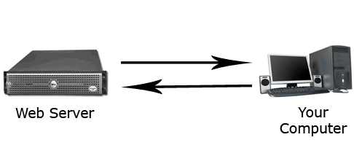
FTP
File Transfer Protocol (FTP)

Slide 31
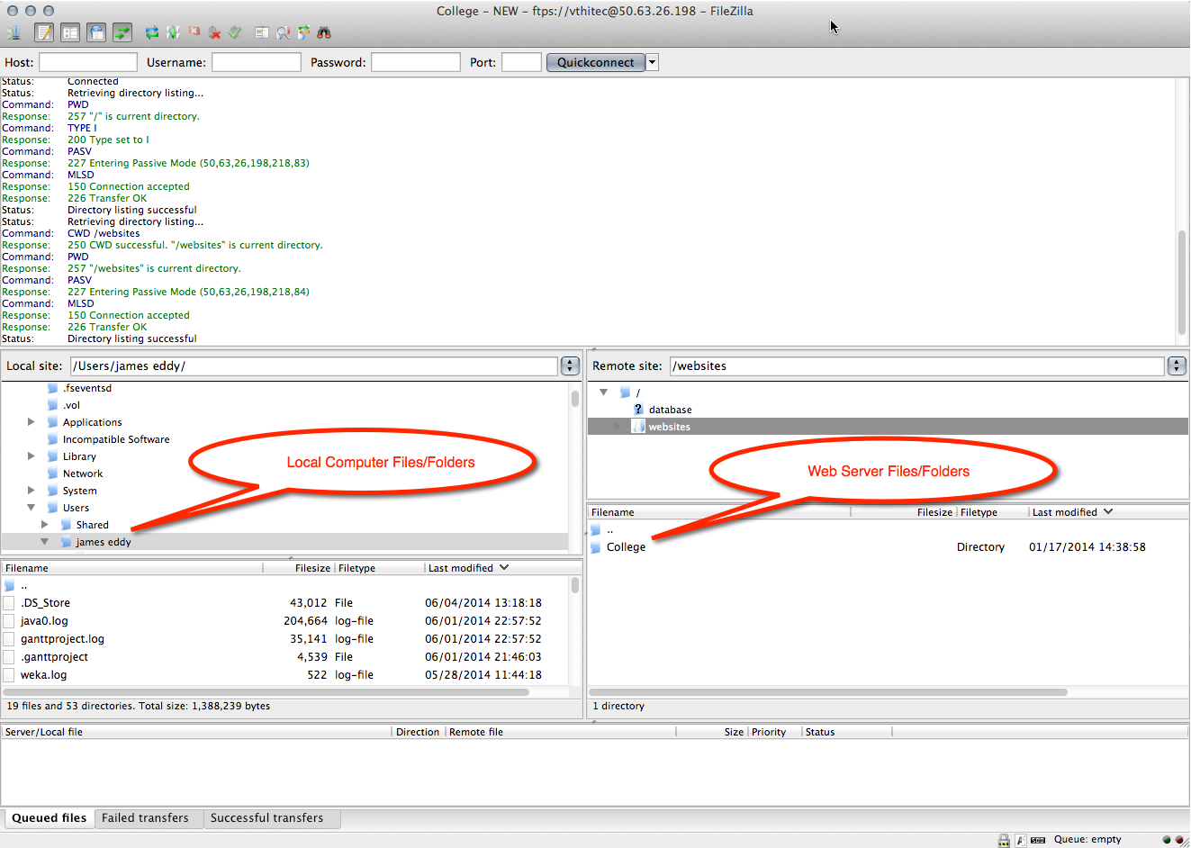
Transferring Files
FTP Client: FileZilla

Slide 32
How Networks Work
How Internet Connections Work

Slide 33
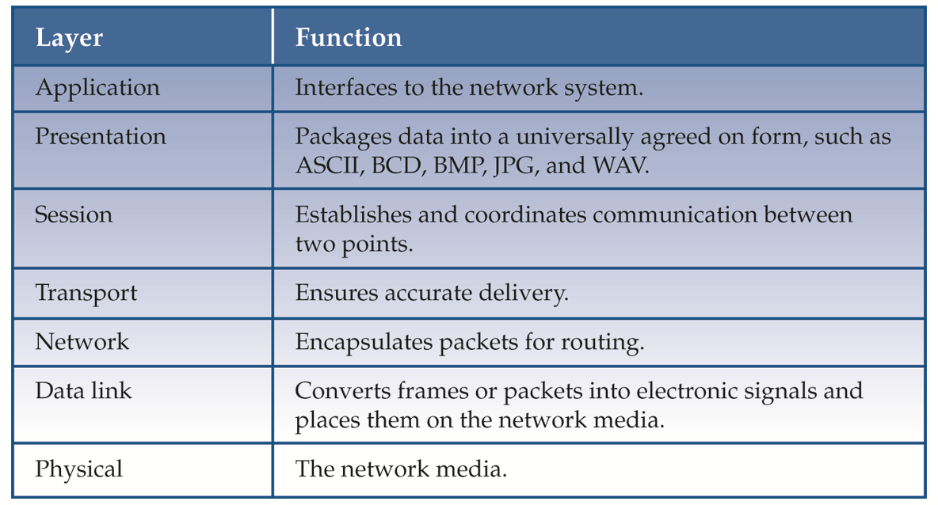
Open Systems Interconnection (OSI) Model

Slide 34
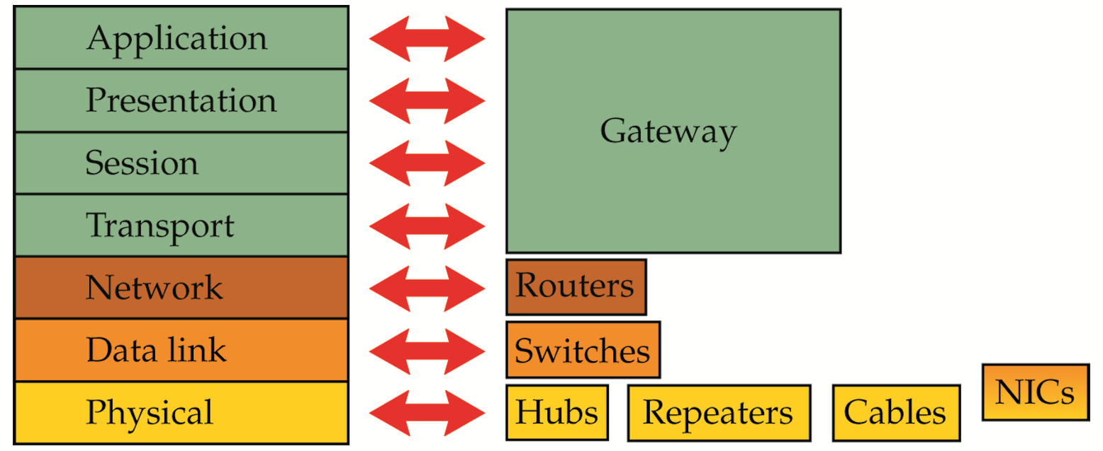
OSI Model

Slide 35
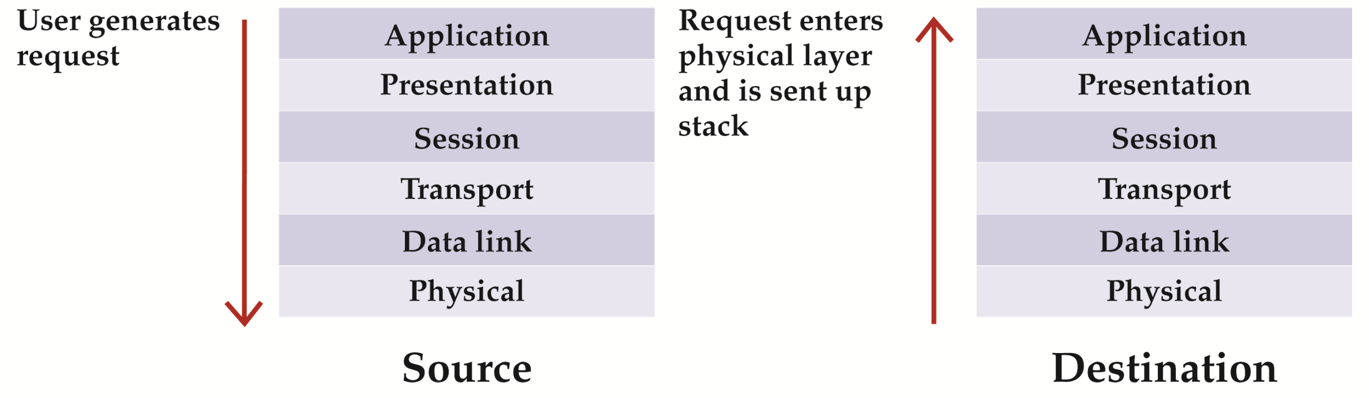
Application Layer
Where the user interfaces with network operating system
Start and final destination of data communication

Slide 36
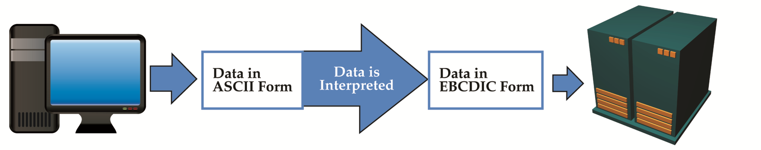
Presentation Layer
Raw data is packaged into a universally agreed on form
Data byte order is also agreed on
Data encryption occurs

Slide 37
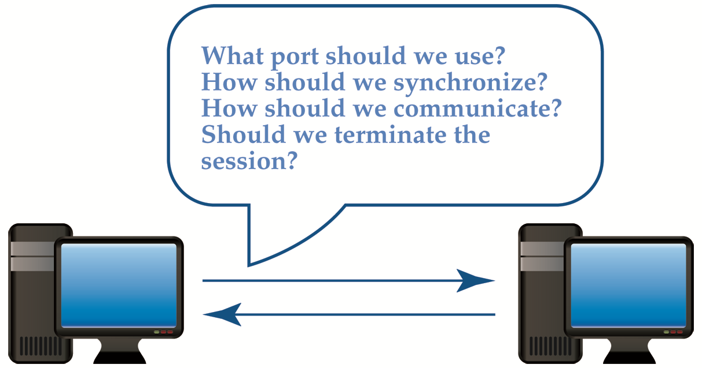
Session Layer
Establishes a dialog between source and destination
Negotiates decisions about how data flow is controlled and how session ends
Decides on whether confirmation of arrival is needed

Slide 38
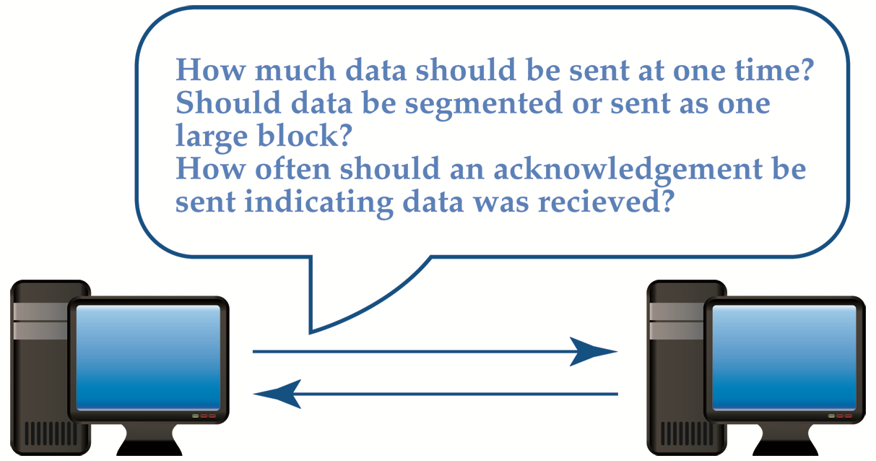
Transport Layer
Responsible for flow of data to and from destination computer

Slide 39
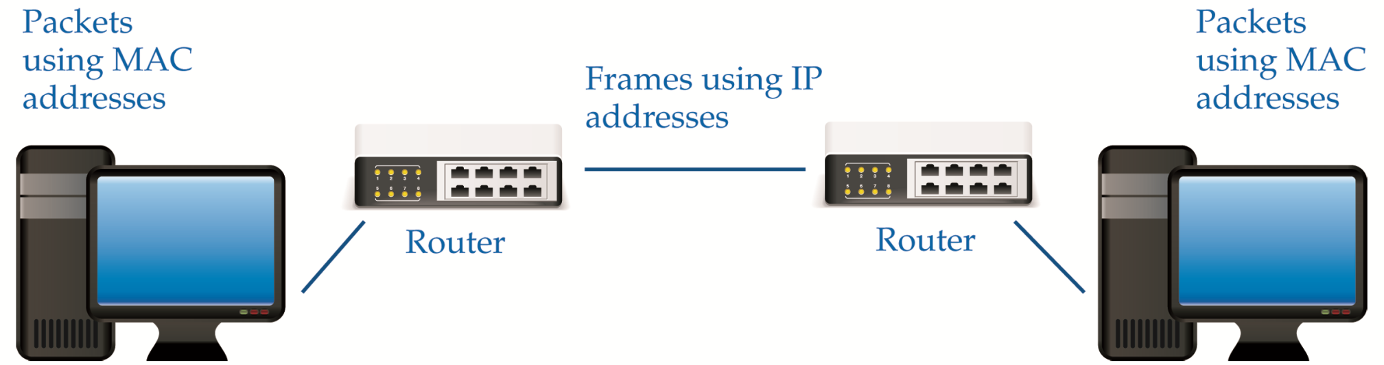
Network Layer
Provides the means of routing data packets across a WAN or MAN
Uses TCP/IP protocol standards
Encapsulates packets with source and destination IP addresses
Responsible for virtual networks

Slide 40

Data Link Layer
Converts data package into electrical pulses and places pulses on network media
Subdivided into logical link control (LLC) and MAC sublayer
Parity and Cyclic Redundancy Checks (CRC) performed

Slide 41
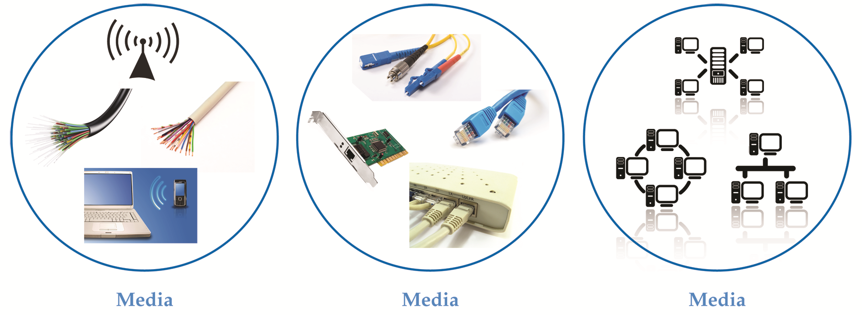
Physical Layer
Concerned with media, hardware, and network topology

Slide 42
OSI Model and Network Devices
Layer 3 Device
Makes decisions about where a packet is sent based on the Internet Protocol
Layer 2 Device
Makes decisions about where a packet is sent based on a MAC address or logical name
Layer 1 Device
Makes no decisions about where a packet is sent

Slide 43
How Networks Work
How Network Security Works

Slide 44
How Networks Work
Subnetting

Slide 45
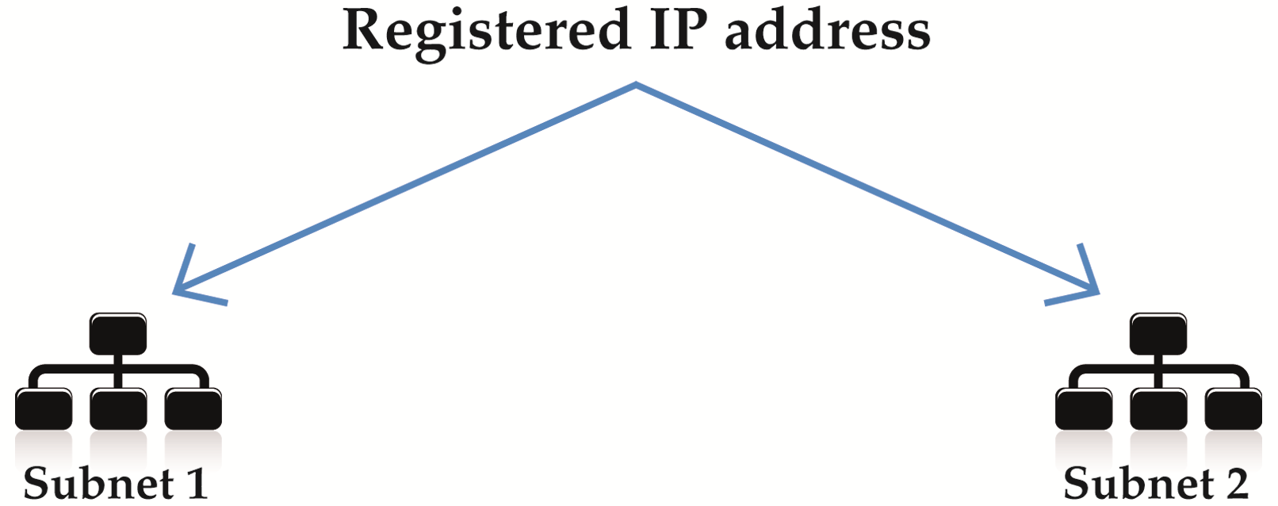
Purpose of Subnetting

Slide 46
Advantages / Disadvantages
Advantages | Disadvantages
Creates a more secure network by placing hosts on separate networks | Can be difficult to manage
Reduces amount of collision on the network | Can be confusing because some equipment use subnets based on all one and all zero bit patterns

Slide 47
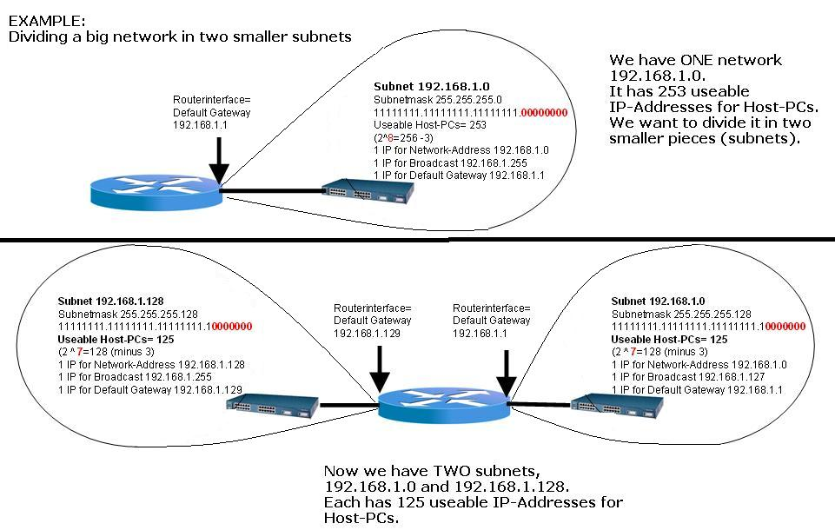

Slide 48
How Networks Work
VPN

Slide 49
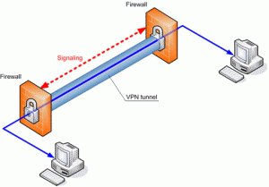
Virtual Private Network (VPN)
Creates a private connection over the Internet or Intranet
VPN software and firewalls provide security
Four most common protocols used in a VPN are PPTP, L2F, L2TP, and IPSec

Slide 50
TCP/IP Troubleshooting Utilities
TCP/IP Utility | Function | When to Use
netstat | Displays current TCP/IP and port statistics | To determine network problems, monitor connections, and check for open ports
nbtstat | Displays NetBIOS over TCP statistics | To see a list of computers currently connected to the network
ping | Sends a packet from one host to another and then echoes a return reply | To quickly check the state of network media between two hosts
tracert or traceroute | Sends a packet from one host to another and gathers statistics and information along the way | To troubleshoot the path to a distant destination
arp | Maps the host MAC address to the host IP address | To verify IP address and MAC address assignments
nslookup | Resolves domain names to IP addresses | To find information about domain names and IP addresses

Slide 51
Pros and Cons
Advantages | Disadvantages
Share software, data, equipment, and communications quickly, easily, and inexpensively | Losing access to files Need additional personnel
Secure data | Vulnerability to hackers, viruses, and disgruntled workers

